Slide 1



Laptop Recommandation
Presented By :
Mohamed Moussa
Abdellatif Shili
Start
Course instructor
Lab instructor
Mohamed Hammemi
Fatma Bouhlel
Notes:
Good morning ,everyone. I hope you are all doing well. My name is Mohamed Moussa, and along with my partner, Abdellatif Shili, we are pleased to present our project: a Laptop Recommendation Model.

Slide 2

Laptop Recommandation
Presented By :
Mohamed Moussa
Abdellatif Shili
Start
Course instructor
Lab instructor
Mohamed Hammemi
Fatma Bouhlel

Slide 3


Plan
Introduction
State of art
Development Process
Project Review
What is Next ?
1
Notes:
Our presentation is divided into five key sections: an introduction, the challenge we face, our development process, a project demo, and a look at our future goals.

Slide 4


Plan
Introduction
State of art
Introduction
Introduce the
Goal of the presentation
Development Process
Project Review
What is Next ?
1

Slide 5
Plan
Introduction
State of art
State of art
The techniques available to create the project
Development Process
Project Review
What is Next ?
1

Slide 6

Plan
Introduction
State of art
Development Process
Reviewing the complete process and key steps undertaken to develop our project.
Development Process
Project Review
What is Next ?
1

Slide 7
Plan
Introduction
State of art
Project Review
Reviewing our project
Using a website
Development Process
Project Review
What is Next ?
1

Slide 8
Plan
Introduction
State of art
Conclusion
Reviewing key concepts and establishing the next objectives
Development Process
Project Review
What is Next ?
1

Slide 9

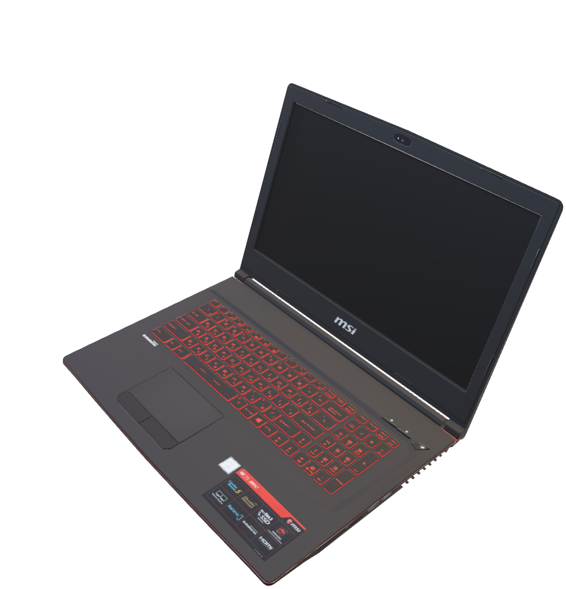
Introduction
State of art
Development Process
Project Review
What is Next ?
In this presentation, we'll explore how machine
learning helps recommend the best PC for users
by analyzing their needs and budget.
Introduction
2
Notes:
In this presentation, we will discuss how machine learning can assist in recommending the most suitable PC for users by evaluating their requirements and budget.

Slide 10

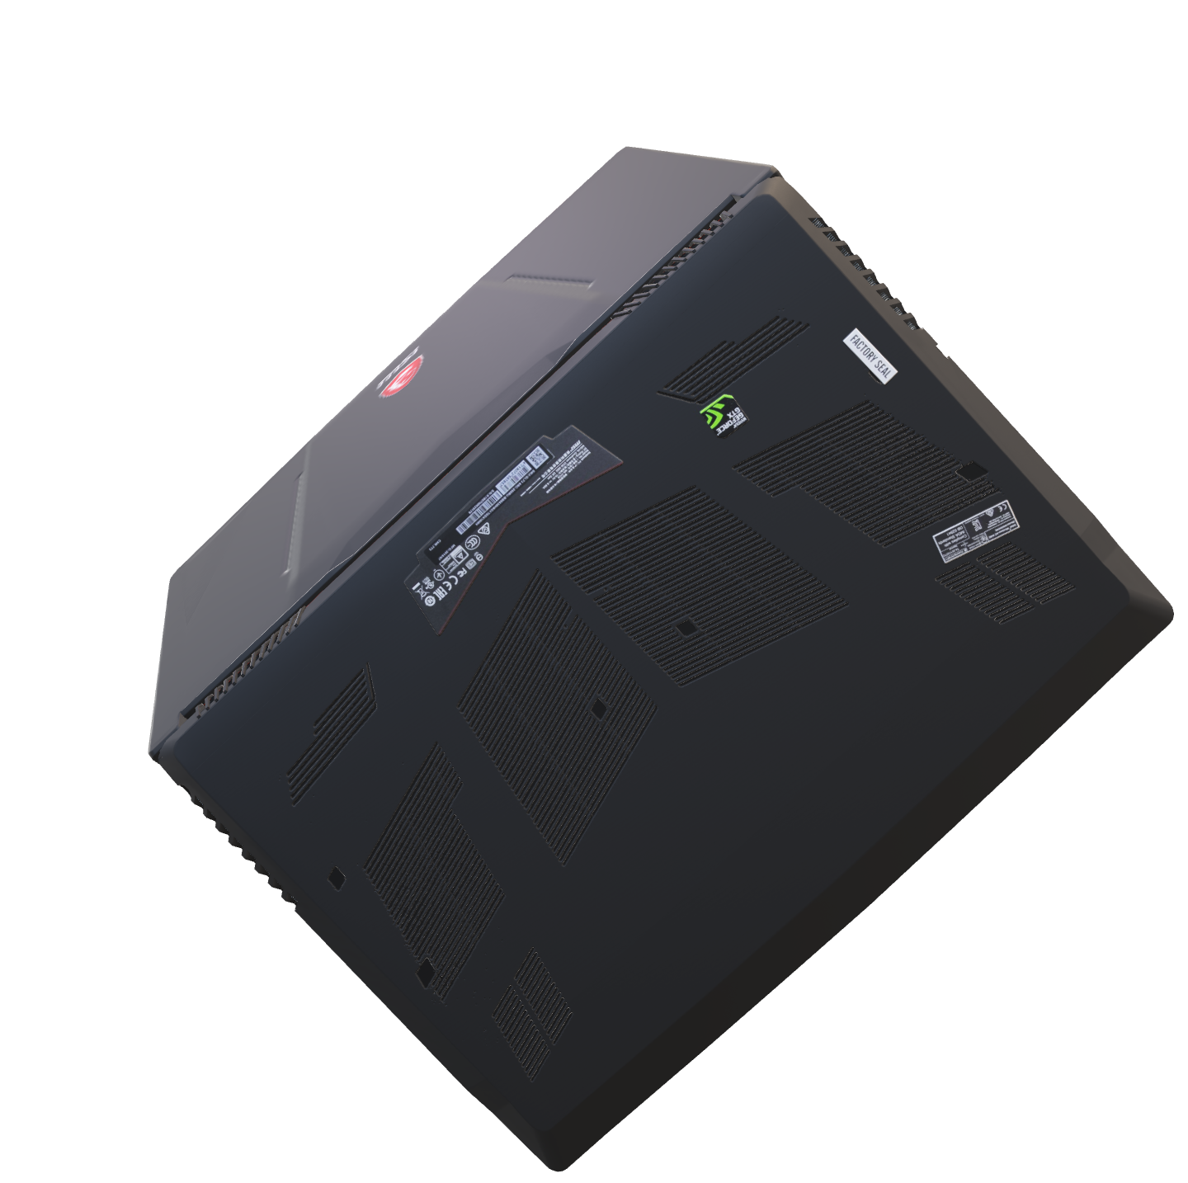
Introduction
State of art
Development Process
Project Review
What is Next ?
GPU
CPU
RAM
3
Notes:
Laptops have become extremely important in our daily lives. While new PCs are released every day, many people still lack knowledge about PC hardware and struggle to find a device that meets their needs without going beyond their budget. But what if there was a way to simplify this process and provide the information they need with just one click?

Slide 11
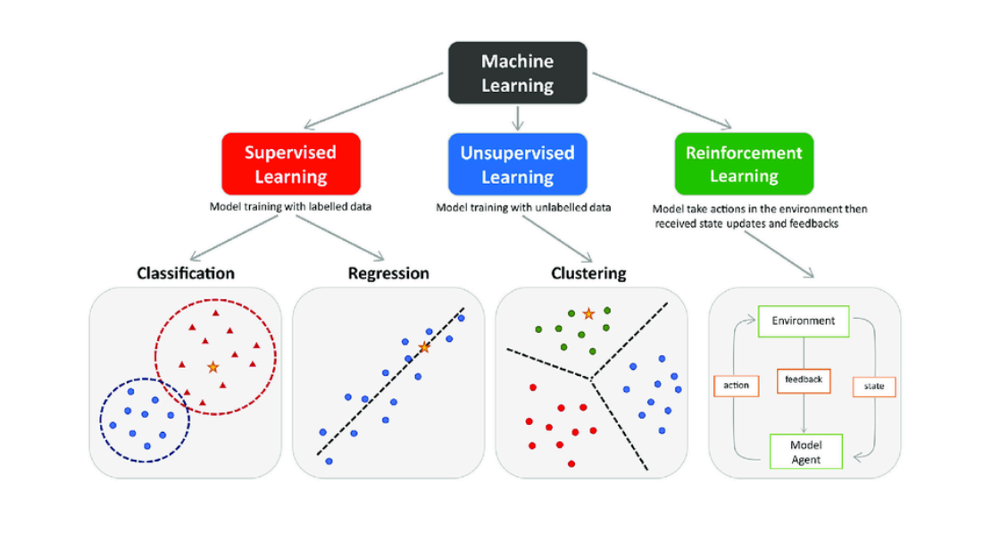


Introduction
State of art
Development Process
Project Review
What is Next ?
State of art
4
Notes:
Machine learning is categorized into three main types, each serving distinct purposes.
The first is supervised learning, which is divided into two subtypes: classification and regression. Classification involves grouping data points into predefined categories, while regression focuses on predicting continuous values, such as estimating the price of a car. Supervised learning relies on labeled data, making it highly accurate but requiring substantial data preparation efforts.
The second type is unsupervised learning, which, unlike supervised learning, works with unlabeled data. Its goal is to uncover hidden patterns or structures, such as grouping data into clusters. While it is cost-effective and useful for exploratory tasks, its results are often less precise and more challenging to interpret.
Finally, we have reinforcement learning, where models learn by interacting with an environment. Through a system of rewards and penalties, the model adapts and improves its decisions. This approach is particularly effective in dynamic and adaptive tasks, such as robotics. However, it is computationally intensive and can take significant time to optimize.

Slide 12


Introduction
State of art
Development Process
Project Review
What is Next ?
Multi-Output Classification Workflow
with Supervised Learning
Data Preparation
Features
Engineering
Methodology
Supervised
Learning
Multi-output
Classifier
5
Notes:
We are using supervised learning with classification because we have a labeled dataset. The goal is to predict three key components of a PC: CPU, GPU, and RAM.
Since we are predicting these three components, classification is the appropriate approach. The specific datasets used will be detailed in the Data Preparation and Feature Engineering sections. And We will use a multi-output classifier to predict all three components at the same time.

Slide 13
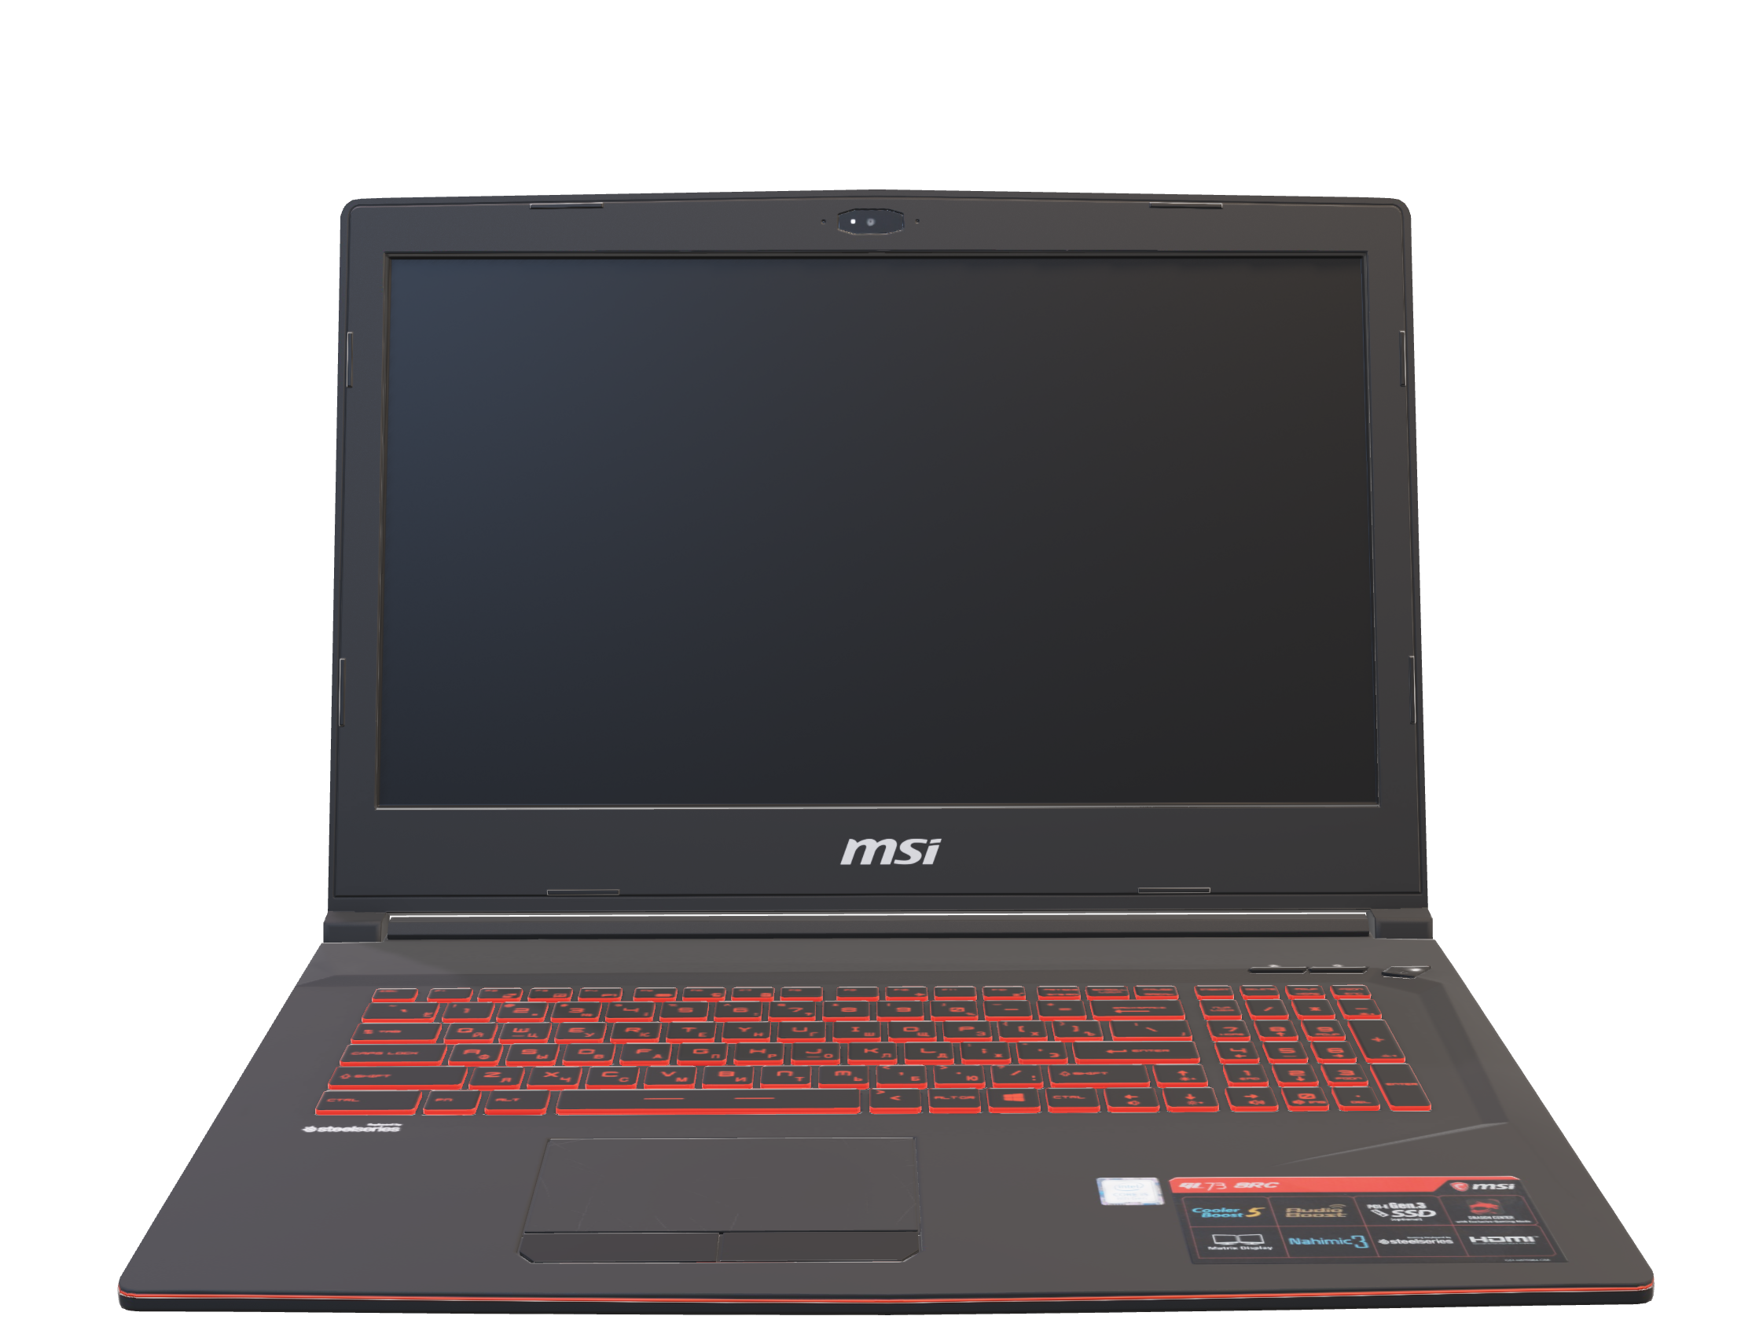
Introduction
State of art
Development Process
Project Review
What is Next ?
Data Preparation
6
Notes:
Diving into our data preparation section

Slide 14
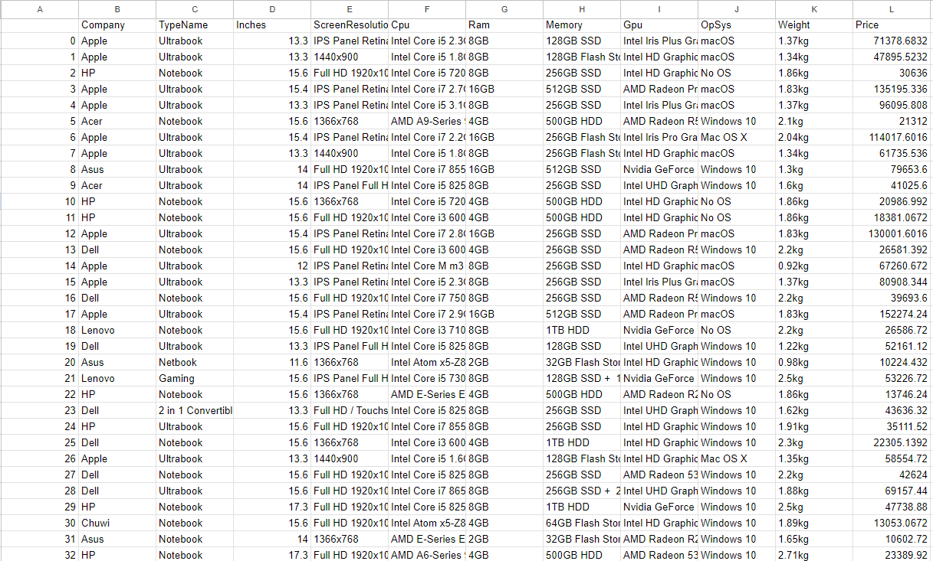


Introduction
State of art
Development Process
Project Review
What is Next ?
Before cleaning
Data Preparation
7
Notes:
let's begin by introducing our starter dataset

Slide 15
Introduction
State of art
Development Process
Project Review
What is Next ?
Samples :1303
Features : 12
Unnamed : unnamed column
Company : the name of the laptop producer
TypeName : Laptop Model
Inches : Diagonal Size of the laptop screen
ScreenResolution: The laptop Screen Resolution
Cpu : The Central Processing Unity
Ram : The laptop RAM capacity
Memory : Hard Disk capacity and type
Gpu : The Graphic Processing Unity
OpSys : Operating System
Weight : Laptop Weight
Price :Laptop Price in rupee
Before cleaning
Data Preparation
8
Notes:
which consists of 12 features and 1,303 samples.

Slide 16
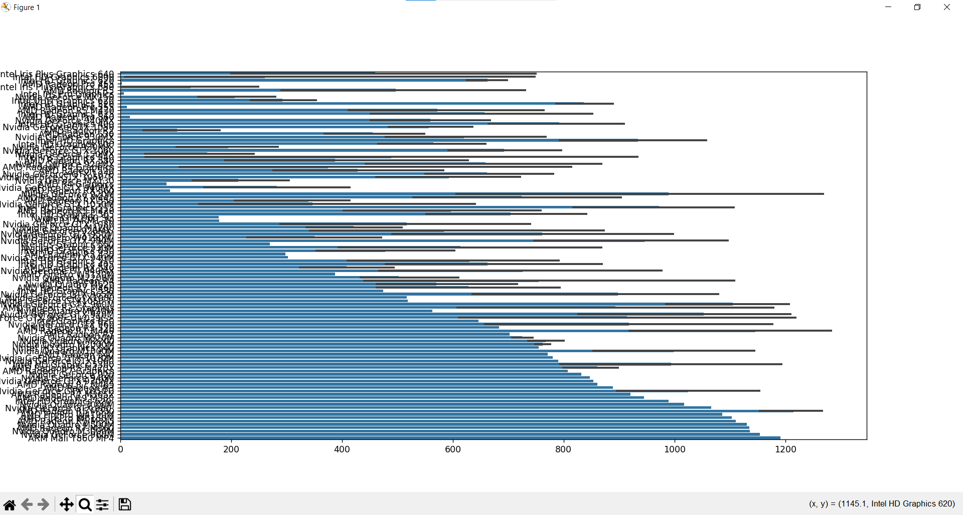
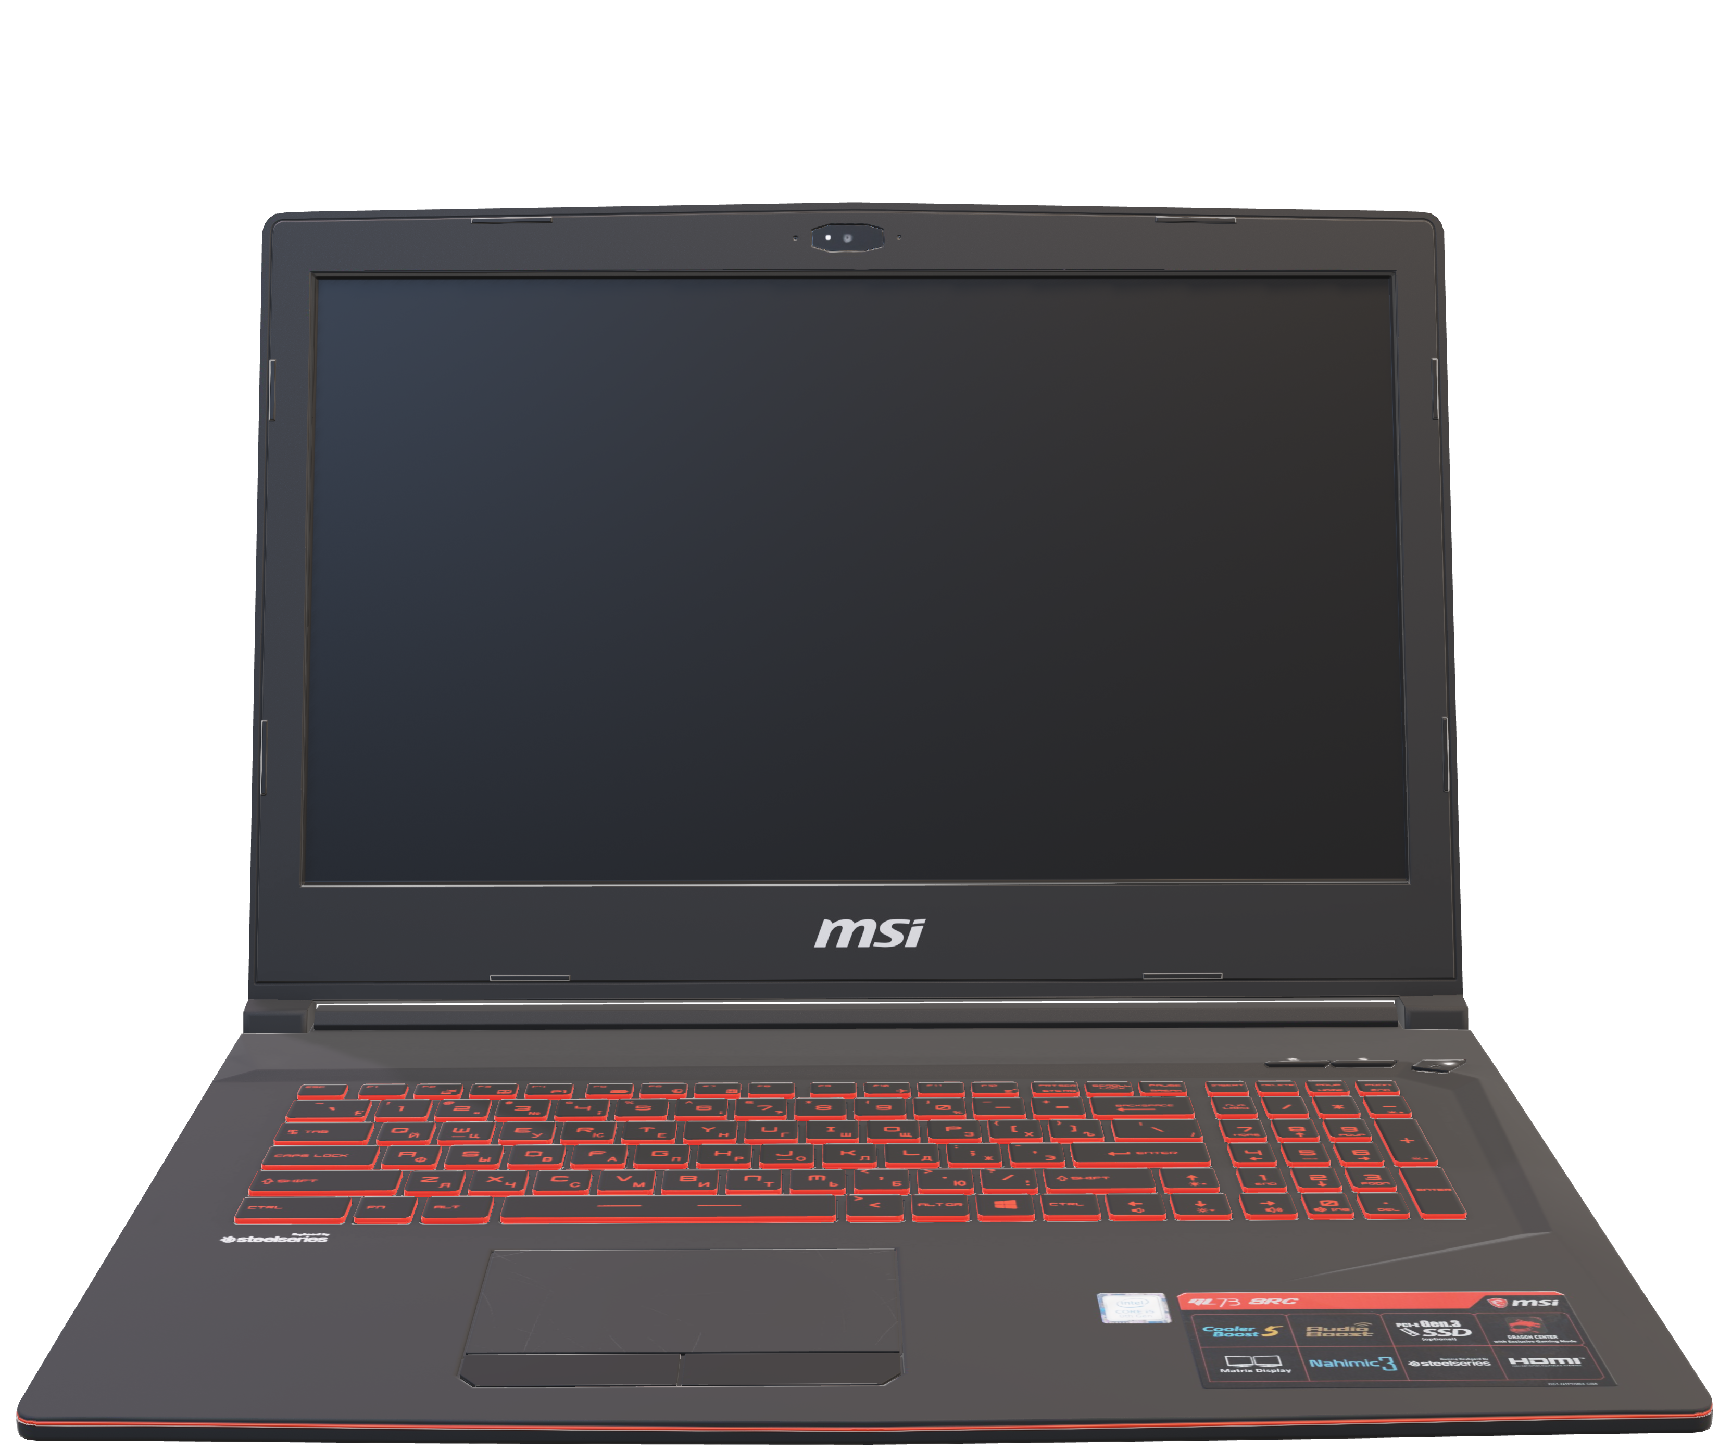
Introduction
State of art
Development Process
Project Review
What is Next ?
GPU Visualization
Before cleaning
Data Preparation
9
Notes:
Oussama : As you can see, visualizing our data is challenging because the labels are not properly formatted, making it impossible to associate each bar with its corresponding label.

Slide 17
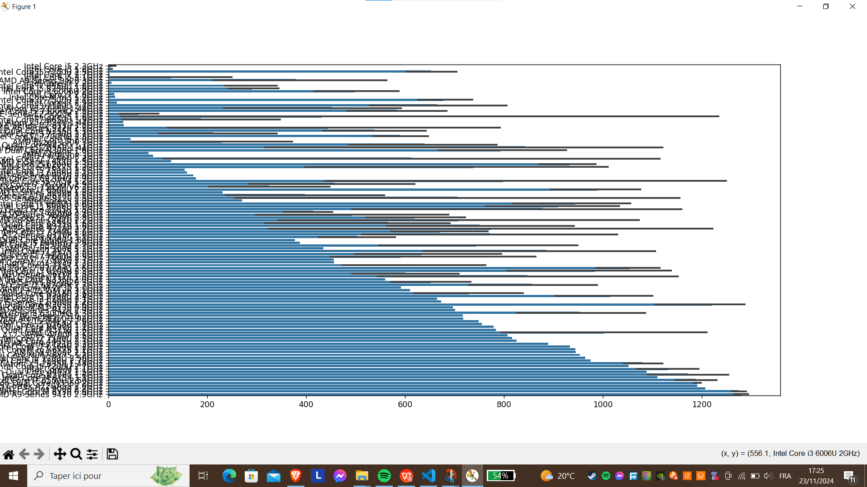
Introduction
State of art
Development Process
Project Review
What is Next ?
GPU Visualization
CPU Visualization
Before cleaning
Data Preparation
10

Slide 18
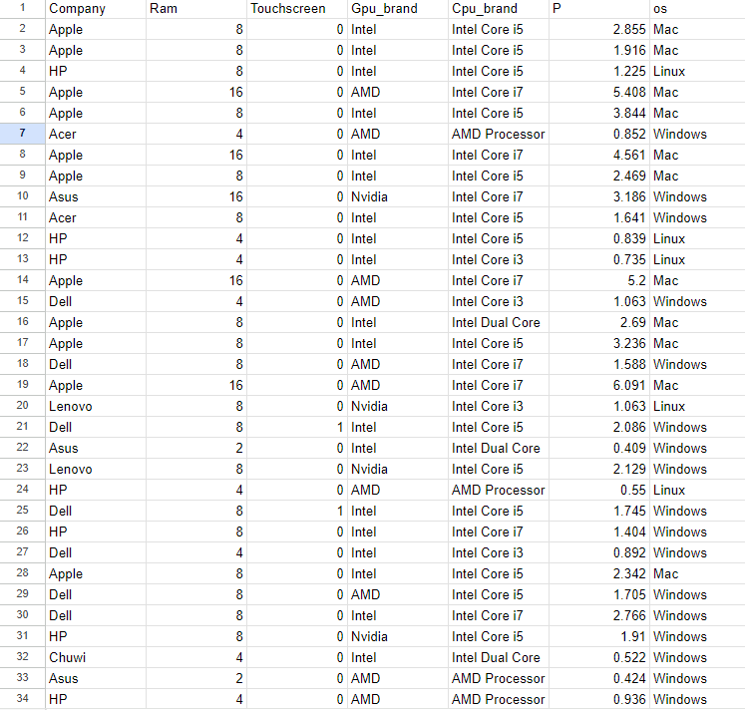
Introduction
State of art
Development Process
Project Review
What is Next ?
After Cleaning
Data Preparation
11
Notes:
This is our dataset after cleaning.

Slide 19
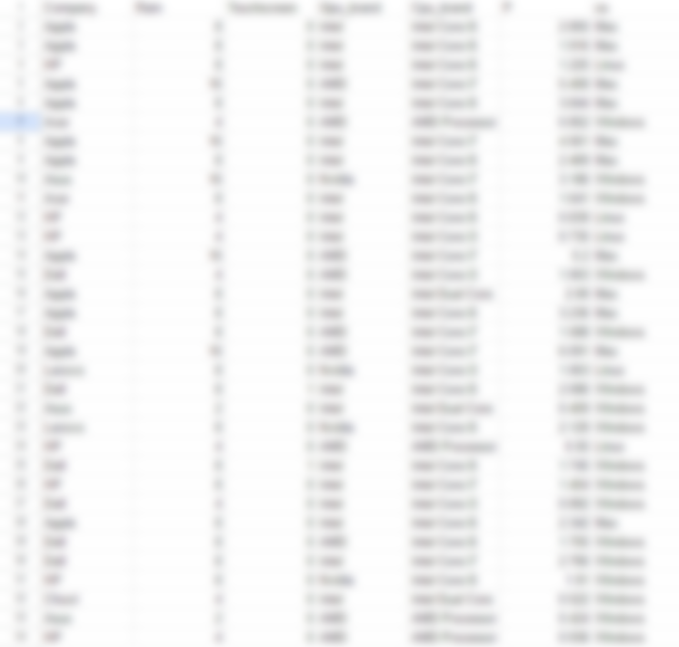
Introduction
State of art
Development Process
Project Review
What is Next ?
After Cleaning
Data Preparation
12

Slide 20
Introduction
State of art
Development Process
Project Review
What is Next ?
After Cleaning
Data Preparation
13
Notes:
What we've done is removing features that don't align with our goals, such as screen size, memory, and TypeName, since they are irrelevant to our predictions. We also updated the labels to make them easier for our model to process. For instance, we removed the "GB" from the RAM values to keep them fully numeric. We also extracted the brand information from the CPU and GPU labels. For example, "NVIDIA RTX 2050" became just "NVIDIA," and "Intel Core i5 7200U" became "Intel Core i5." This helps prevent the model from generating too many unique combinations, which could complicate predictions, especially given the limited size of our dataset. We simplified the operating system label by changing "Windows 10" to "Windows.“ for example We also converted the price from rupees to Tunisian dinar since our target market is in Tunisia. Finally, we extracted a feature to indicate whether the screen supports touch functionality from the screen Resolution feature . This is important because touch-screen capability significantly impacts the price of a PC. Dropping this feature could result in inaccurate predictions, like assigning a high price to a PC with low specs, which we want to avoid.

Slide 21
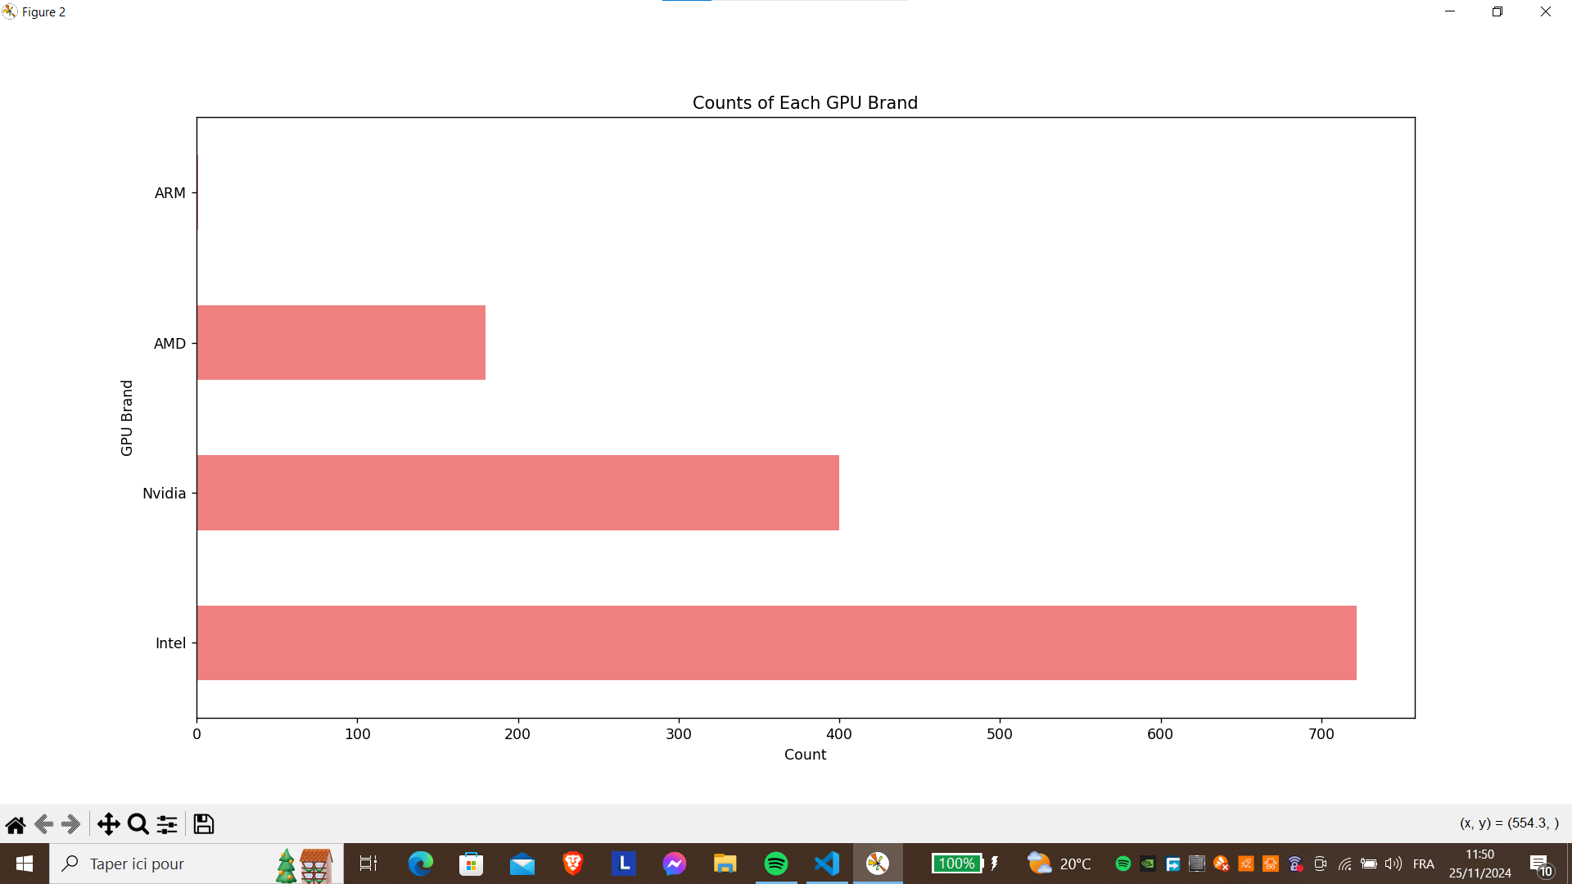
Introduction
State of art
Development Process
Project Review
What is Next ?
After Cleaning
Data Preparation
14
Notes:
As you can see, the visualization is now much clearer, and we can explore our dataset more easily. For instance, we noticed that we only have one ARM GPU,

Slide 22
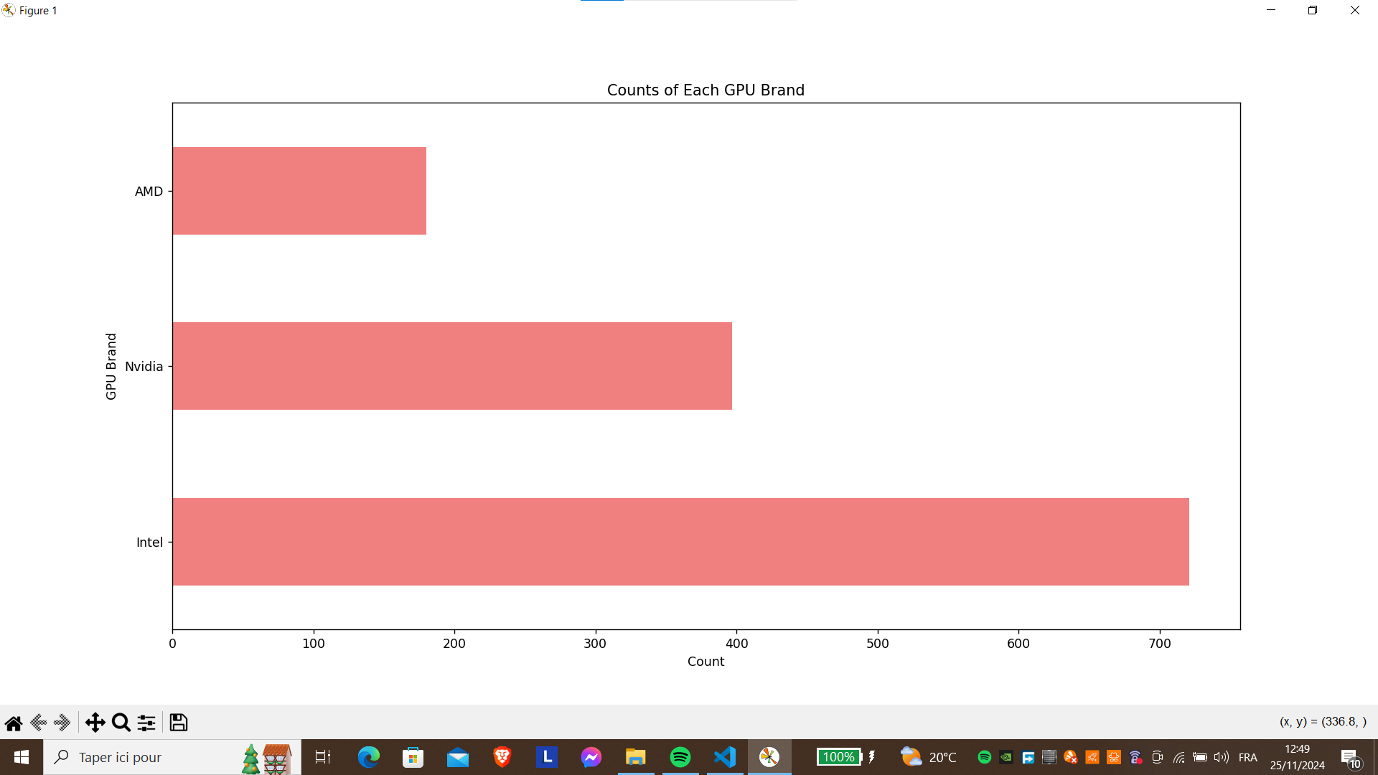
Introduction
State of art
Development Process
Project Review
What is Next ?
After Cleaning
Data Preparation
15
Notes:
so we decided to drop it. This helps us streamline the dataset and focus on the most relevant features for our predictions.

Slide 23
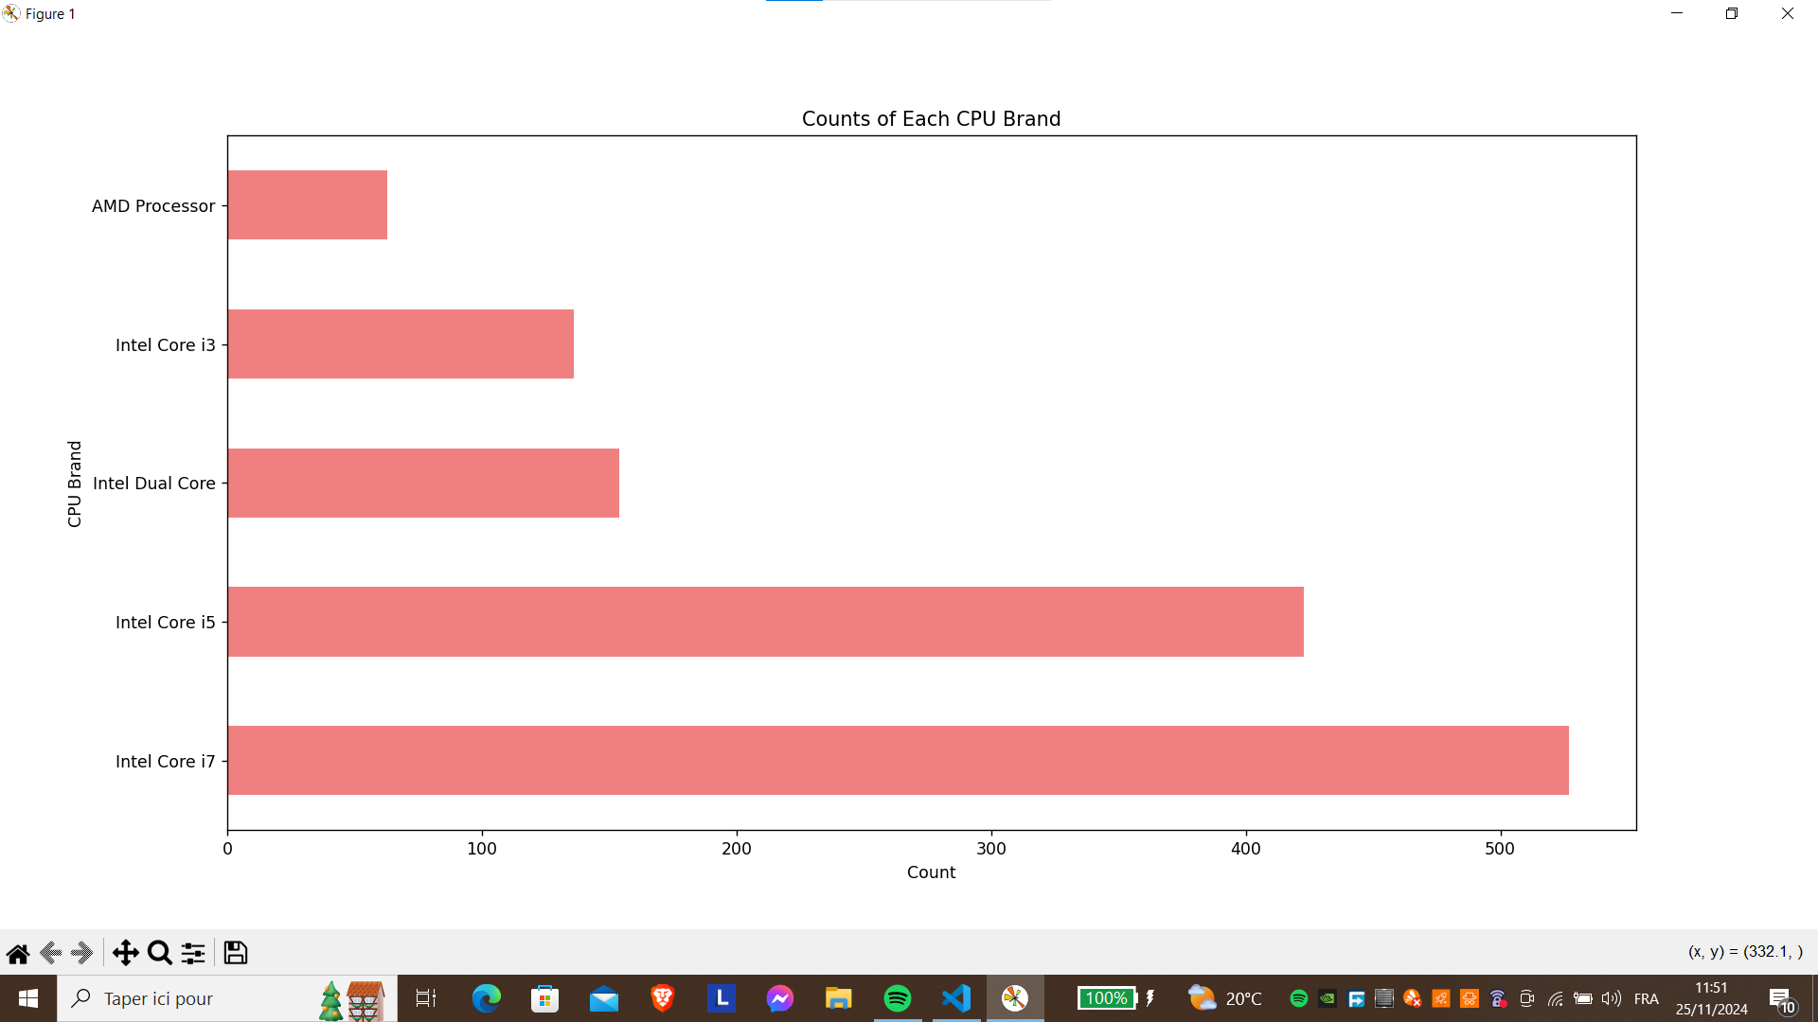
Introduction
State of art
Development Process
Project Review
What is Next ?
After Cleaning
Data Preparation
16
Notes:
This is the visualization of our Cpu brand feature

Slide 24
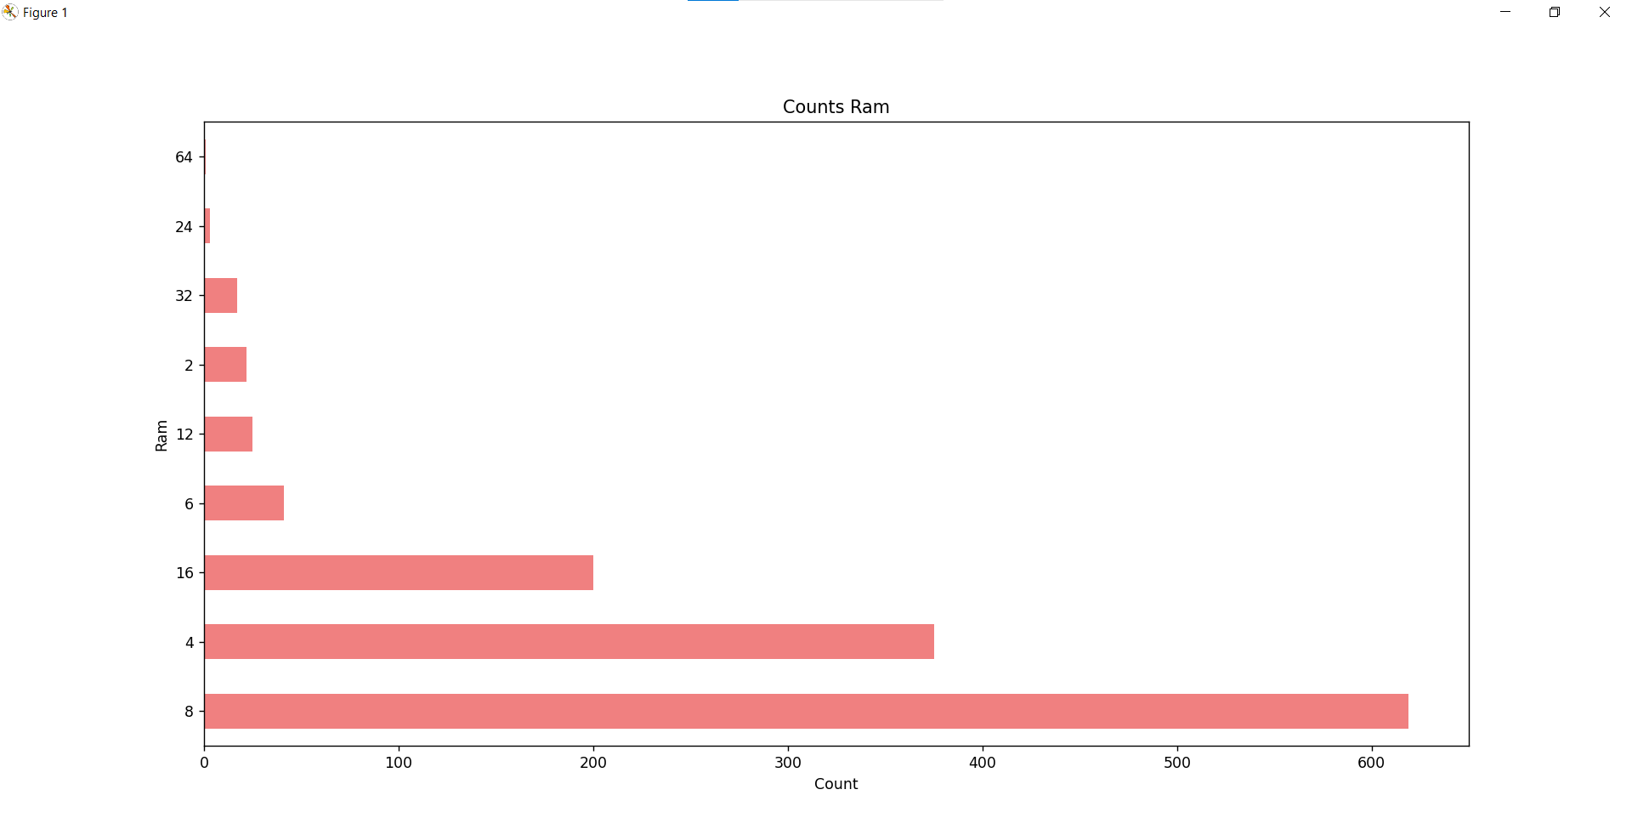
Introduction
State of art
Development Process
Project Review
What is Next ?
After Cleaning
Data Preparation
17
Notes:
Here, we noticed that the counts for 64GB and 24GB RAM capacities were incredibly low,

Slide 25
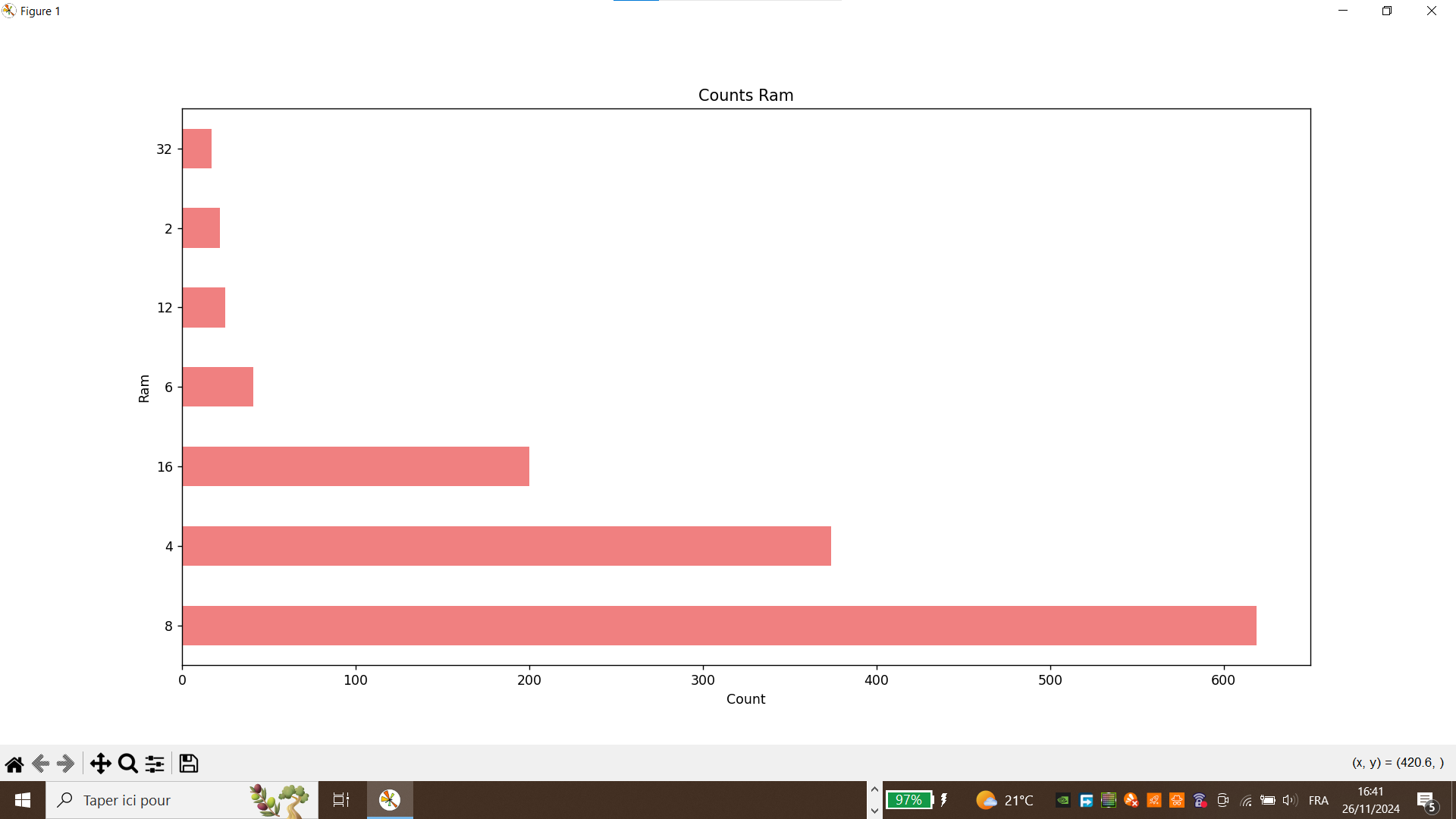
Introduction
State of art
Development Process
Project Review
What is Next ?
After Cleaning
Data Preparation
18
Notes:
so we decided to remove them.

Slide 26
Introduction
State of art
Development Process
Project Review
What is Next ?
Multi-Output Classification Workflow
with Supervised Learning
Data Preparation
Features
Engineering
Methodology
Supervised
Learning
Multi-output
Classifier
19

Slide 27
Introduction
State of art
Development Process
Project Review
What is Next ?
Features
Engineering
20
Notes:
Now, we will dive into our feature engineering section.

Slide 28
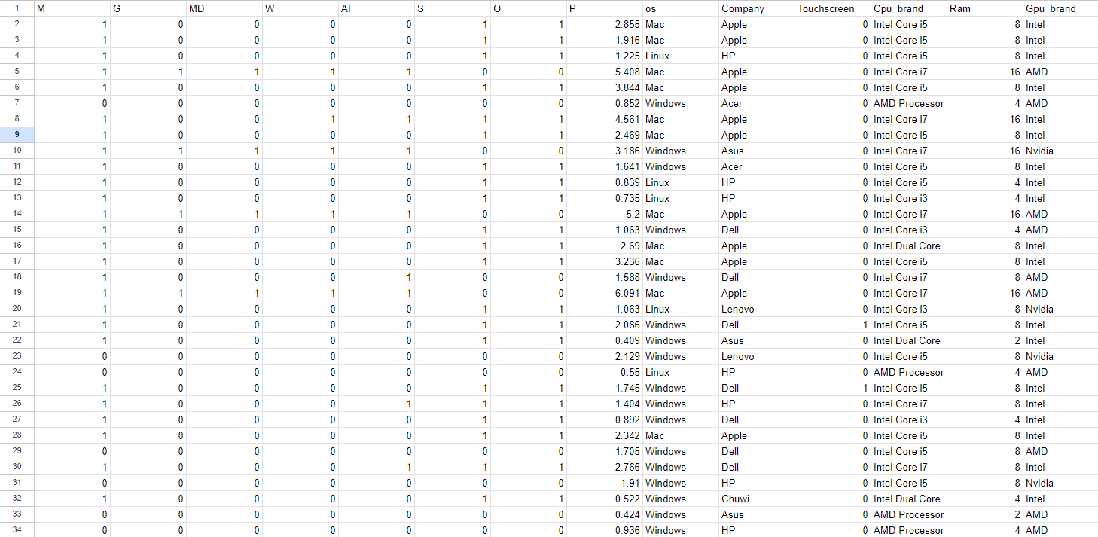
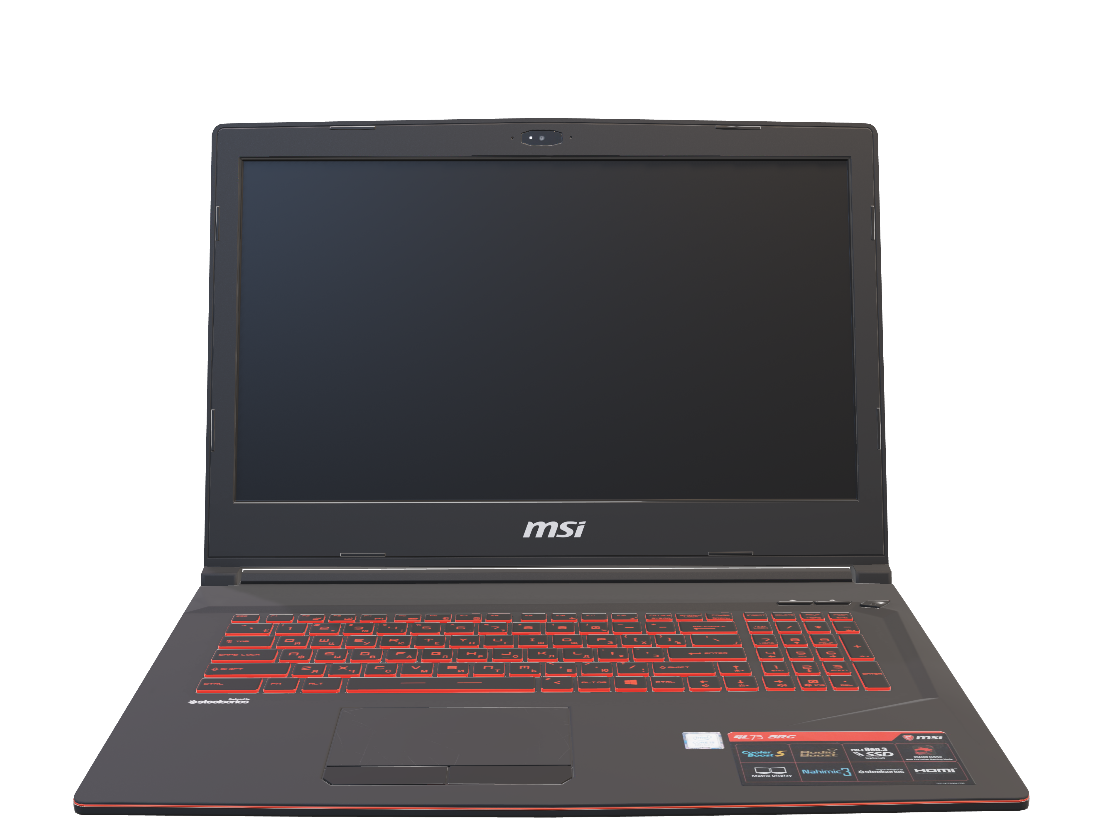
Introduction
State of art
Development Process
Project Review
What is Next ?
Features Engineering
21
Notes:
As mentioned at the beginning, Many people struggle to find the right PC because they lack knowledge about PC hardware. However, they usually have a clear understanding of their budget and the intended purpose of the PC. To address this issue, we focused on developing a logic that add features into our dataset, representing various PC needs such as gaming, multitasking, mobile development, and more..

Slide 29

Introduction
State of art
Development Process
Project Review
What is Next ?
M :MultiTasking
G : Gaming
MD : Mobile Development
W : Web Development
AI : Artificial Intelligence
S: School
O : Office
Features Engineering
22
Notes:
For the sake of simplicity and clarity, we chose to use the first one or two letters of each label, making our dataset structured and easy to understand

Slide 30
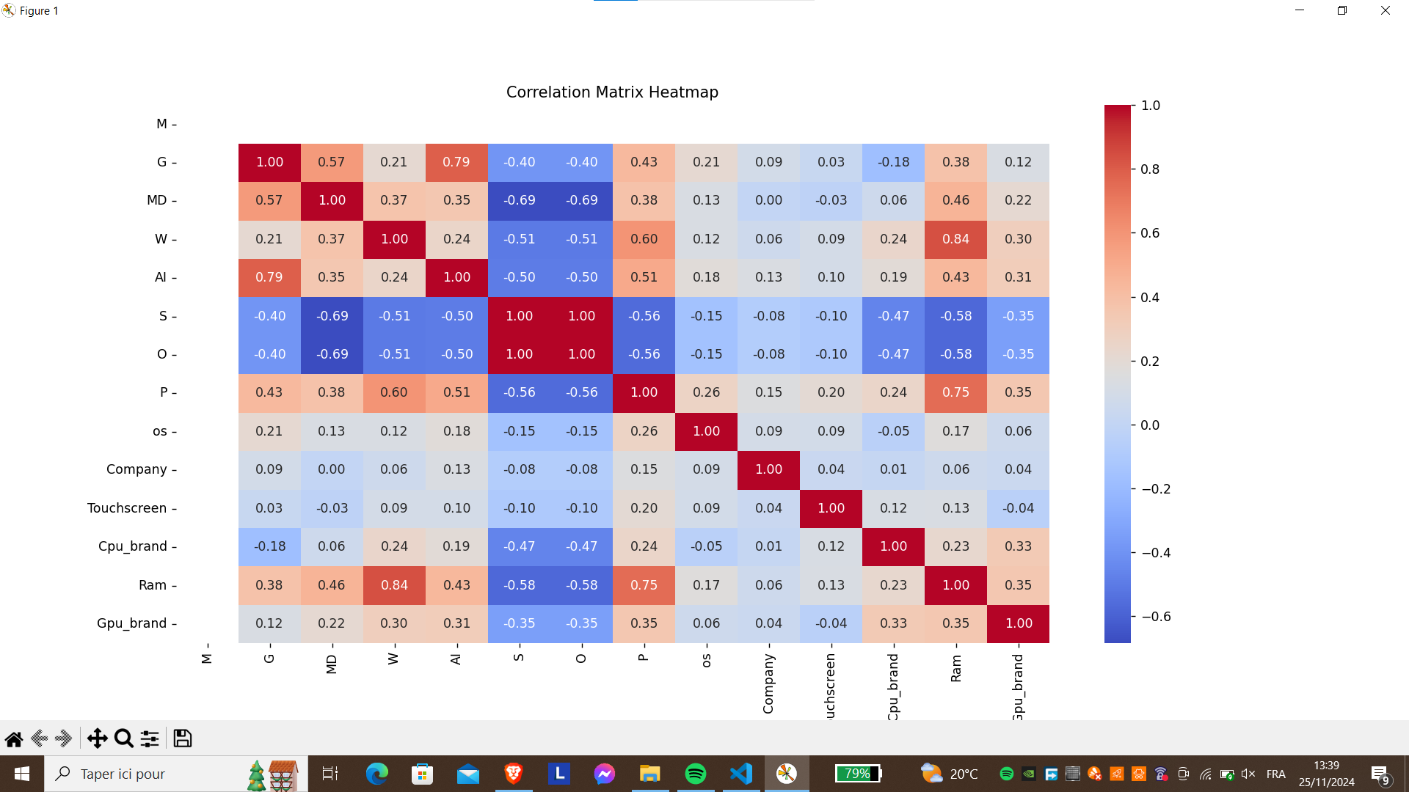
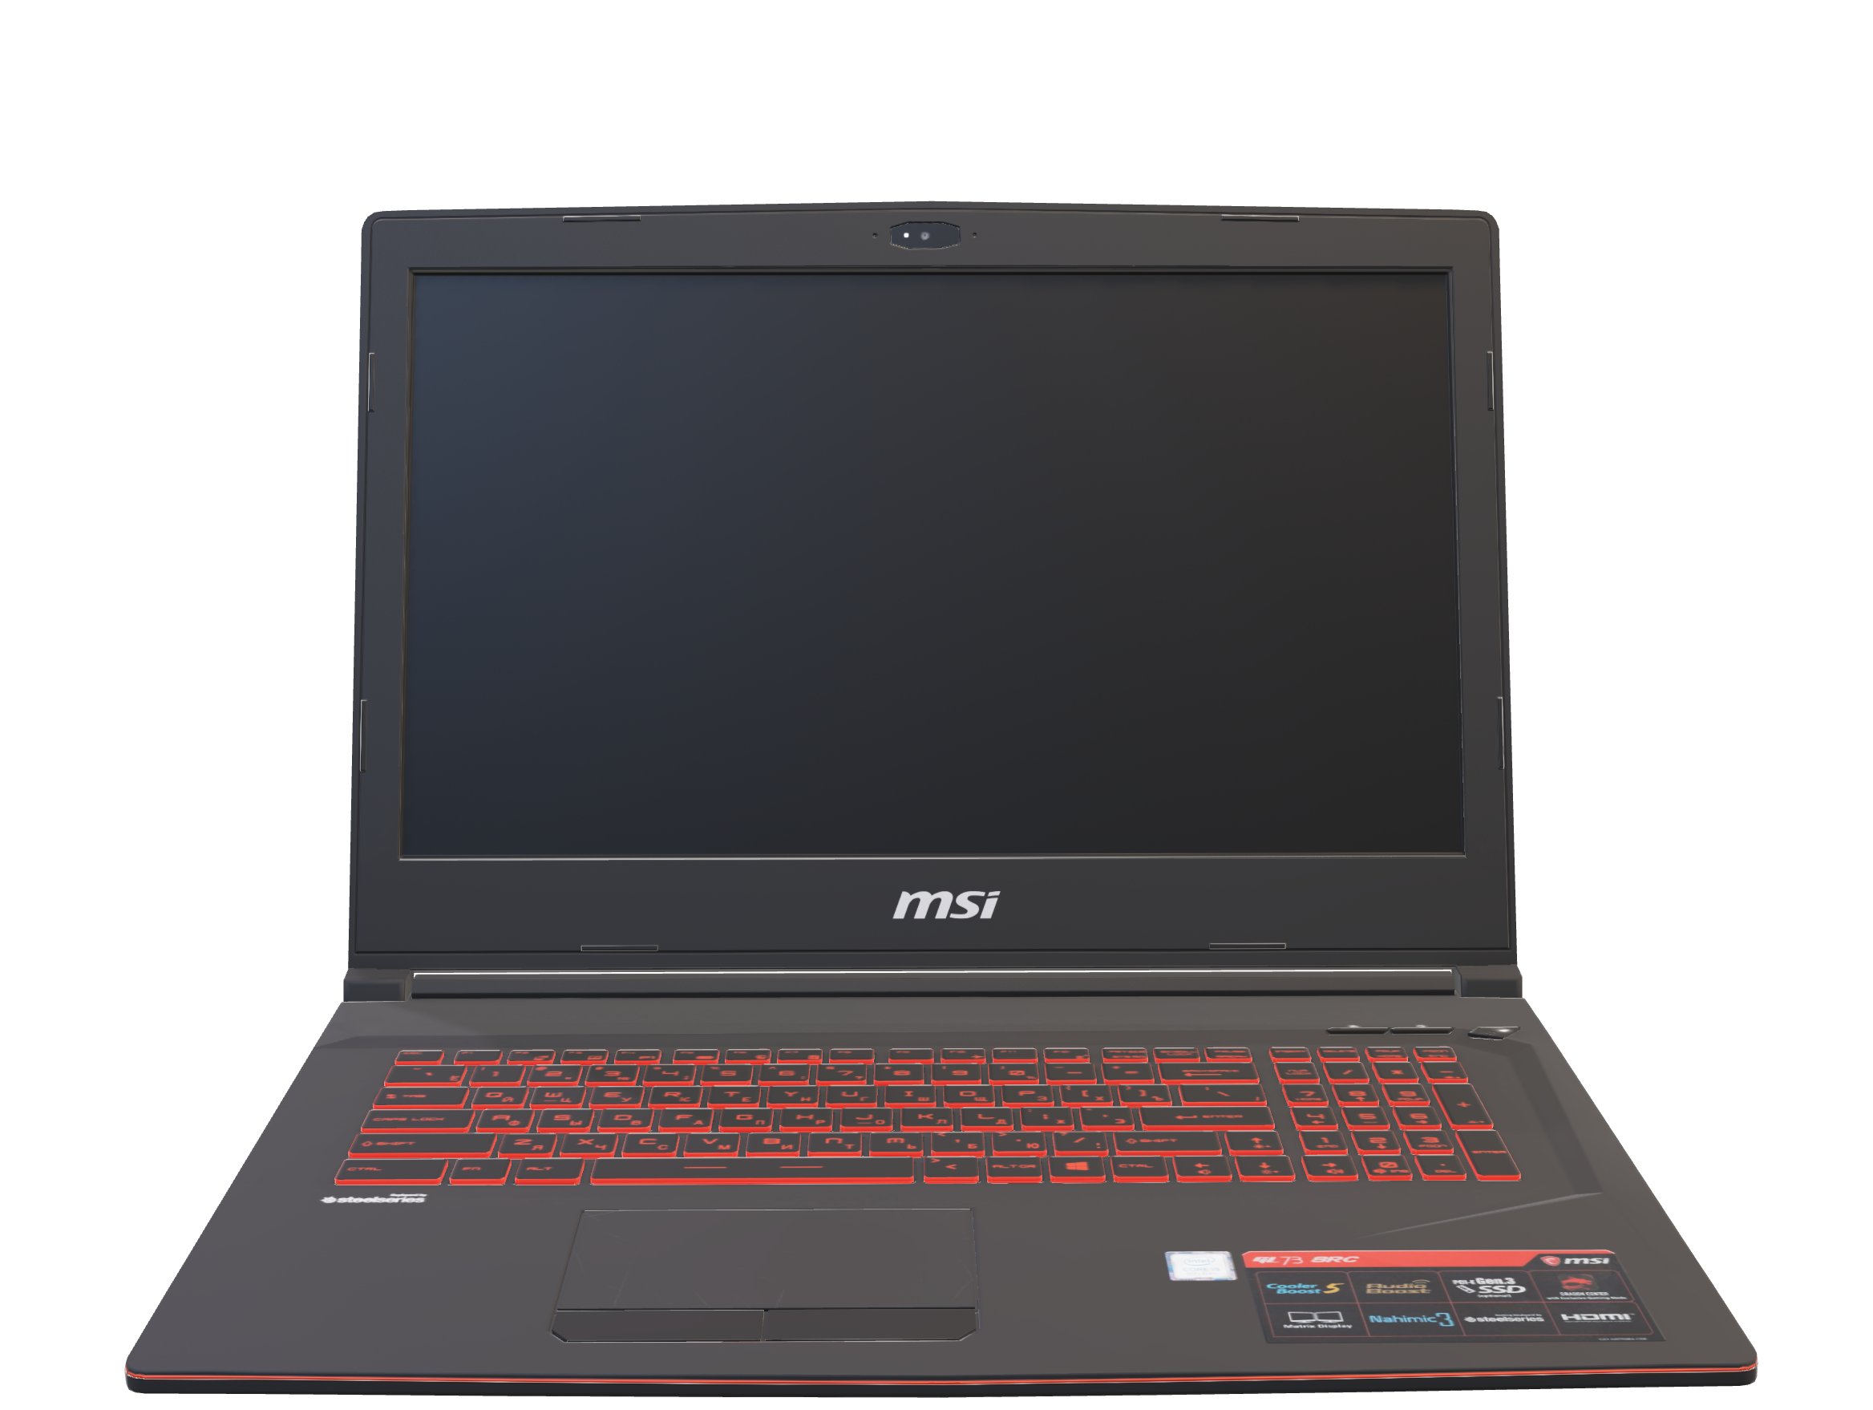
Introduction
State of art
Development Process
Project Review
What is Next ?
Features Engineering
23
Notes:
Here is our correlation matrix.

Slide 31
Introduction
State of art
Development Process
Project Review
What is Next ?
Features Engineering
24
Notes:
We decided to drop the multitasking feature since its value is always 1, making it redundant. Additionally, you can see that "office" and "school" share the same values. We chose to keep only one of them, even though it shows a negative correlation, as it is essential for achieving our project goal.

Slide 32


Introduction
State of art
Development Process
Project Review
What is Next ?
Multi-Output Classification Workflow
with Supervised Learning
Data Preparation
Features
Engineering
Methodology
Supervised
Learning
Multi-output
Classifier
25
Notes:
Next, we'll discuss supervised learning and the multi-output classifier, which are grouped together because the model is encapsulated within the multi-output classifier.

Slide 33
Introduction
State of art
Development Process
Project Review
What is Next ?
Multi-Output Classification Workflow
with Supervised Learning
Data Preparation
Features
Engineering
Methodology
Supervised
Learning
Multi-output
Classifier
26

Slide 34
Introduction
State of art
Development Process
Project Review
What is Next ?
Supervised
Learning
Multi-output
Classifier
27

Slide 35
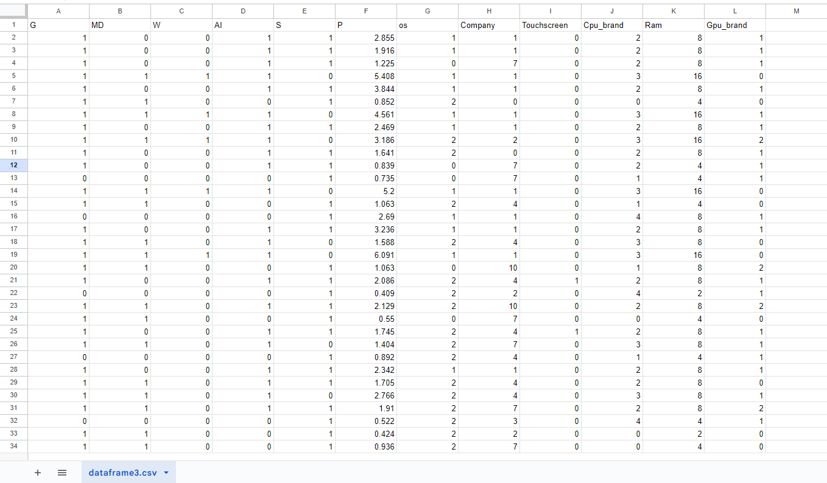
Introduction
State of art
Development Process
Project Review
What is Next ?
categorization
Supervised Learning + Multi-output classifier
28
Notes:
Before starting the process, we converted non-numerical features to numerical ones to prevent errors during predictions.

Slide 36
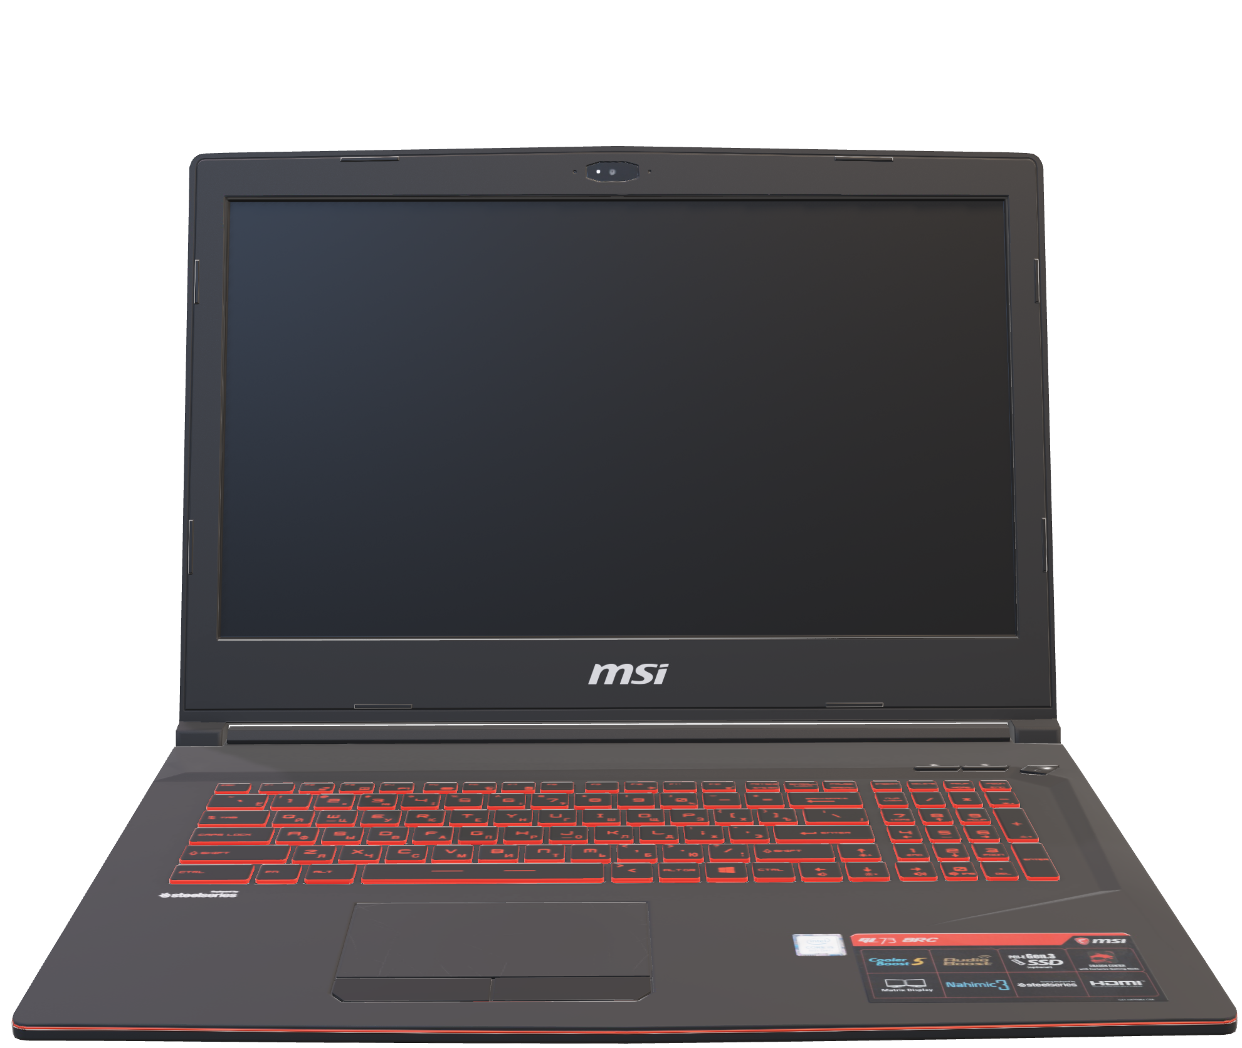
Introduction
State of art
Development Process
Project Review
What is Next ?
categorization
For the modeling we’ve tested these algorithms :
SVC (Support Vector Classifier)
Algorithms
Logistic Regression
Supervised Learning + Multi-output classifier
Random Forest
K-Nearest Neighbors (KNN)
29
Notes:
For the modeling we've tested tested these algorithms

Slide 37
Introduction
State of art
Development Process
Project Review
What is Next ?
categorization
For the modeling we’ve tested these algorithms :
SVC (Support Vector Classifier)
Algorithms
Logistic Regression
+
Multi-output classifier
Supervised Learning + Multi-output classifier
Multi-output
classifier
Random Forest
K-Nearest Neighbors (KNN)
30
Notes:
each wrapped within a multi-output classifier.

Slide 38
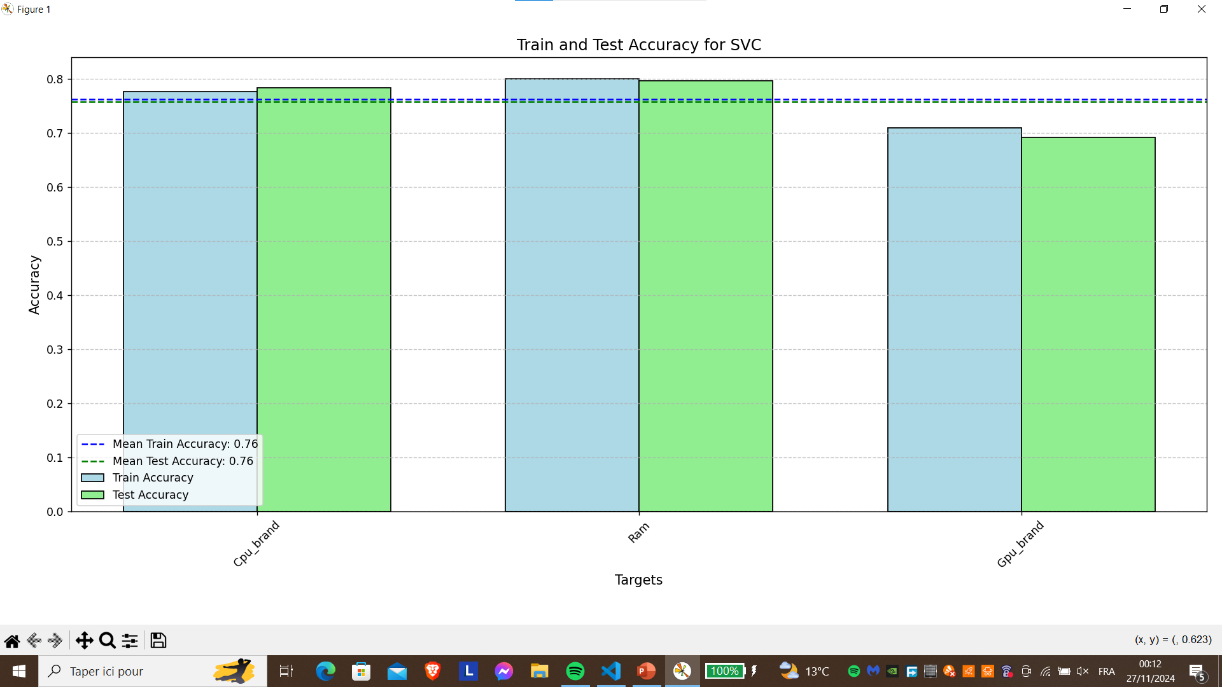

Introduction
State of art
Development Process
Project Review
What is Next ?
categorization
Algorithms
Supervised Learning + Multi-output classifier
Multi-output
classifier
31
Notes:
Here are the accuracy results of the SVC model for predicting the CPU, RAM, and GPU.

Slide 39
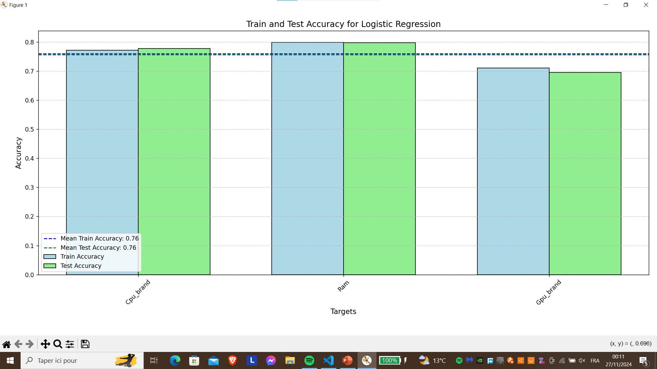
Introduction
State of art
Development Process
Project Review
What is Next ?
categorization
Algorithms
Supervised Learning + Multi-output classifier
Multi-output
classifier
32
Notes:
This is the logistic regression

Slide 40
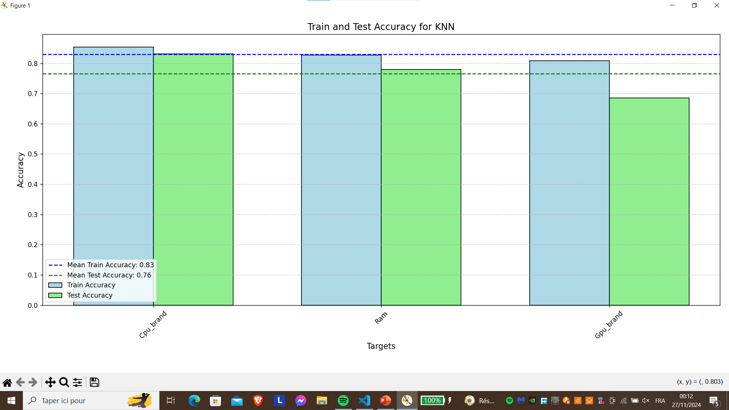
Introduction
State of art
Development Process
Project Review
What is Next ?
categorization
Algorithms
Supervised Learning + Multi-output classifier
33
Notes:
This is the knn

Slide 41
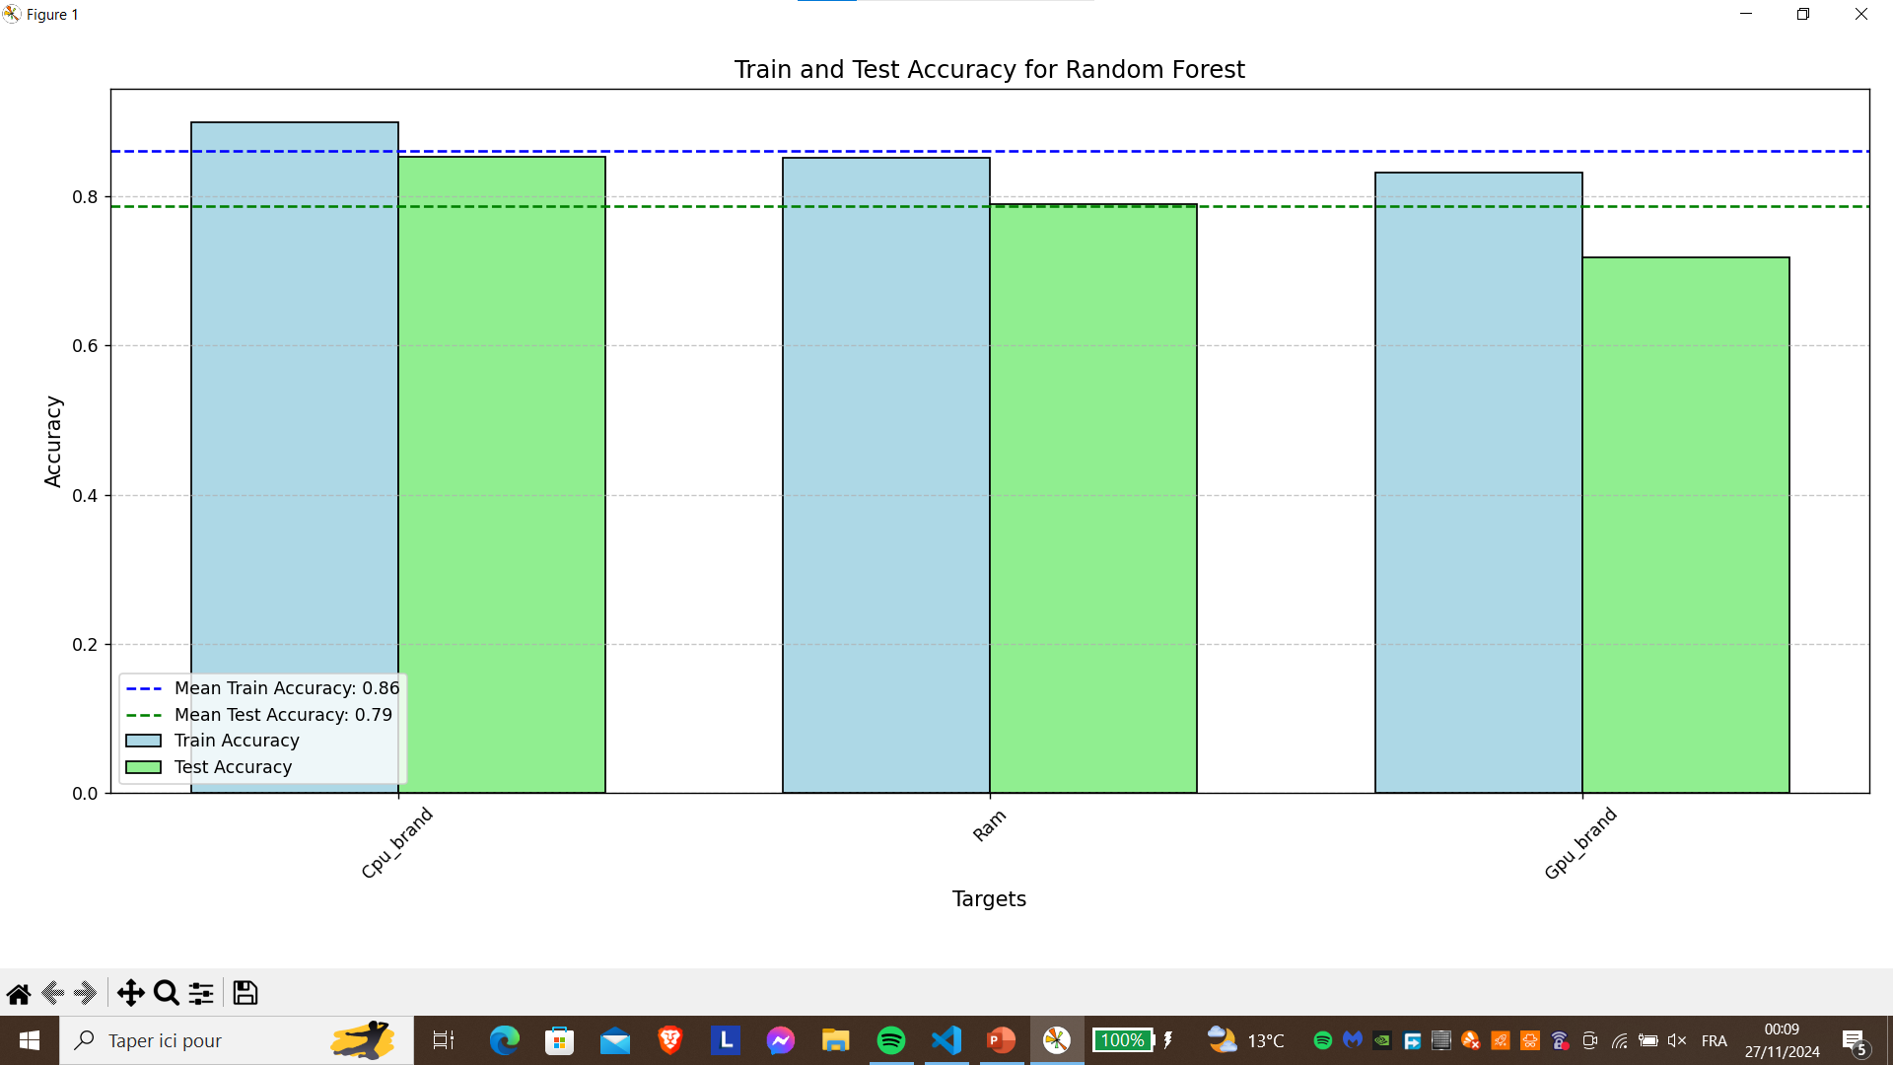
Introduction
State of art
Development Process
Project Review
What is Next ?
categorization
Algorithms
Supervised Learning + Multi-output classifier
Multi-output
classifier
34
Notes:
This the random Forest

Slide 42
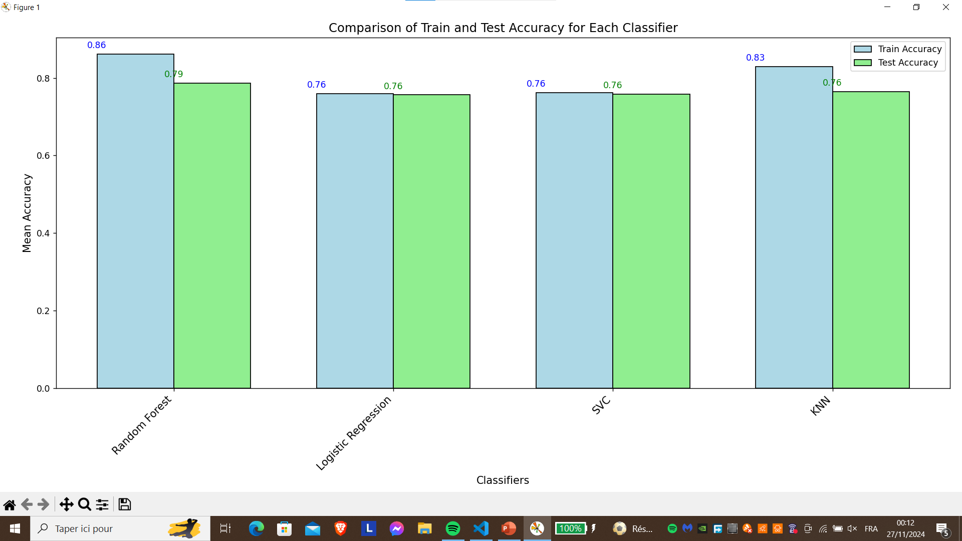
Introduction
State of art
Development Process
Project Review
What is Next ?
categorization
Algorithms
Supervised Learning + Multi-output classifier
Multi-output
classifier
35
Notes:
Here is the comparison between the four models.

Slide 43
Introduction
State of art
Development Process
Project Review
What is Next ?
categorization
Algorithms
Supervised Learning + Multi-output classifier
Multi-output
classifier
36
Notes:
As you can see, the Random Forest model achieves the best overall accuracy.

Slide 44
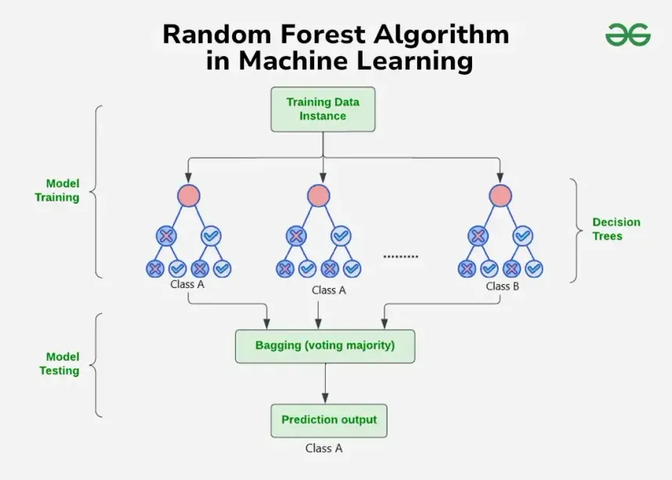
Introduction
State of art
Development Process
Project Review
What is Next ?
categorization
Algorithms
Supervised Learning + Multi-output classifier
Multi-output
classifier
37

Slide 45
Introduction
State of art
Development Process
Project Review
What is Next ?
38

Slide 46

Introduction
State of art
Development Process
Project Review
What is Next ?
39
Notes:
Oussama We created a website using Flask as a demo to showcase the output of the model.

Slide 47
Introduction
State of art
Development Process
Project Review
What is Next ?
39

Slide 48
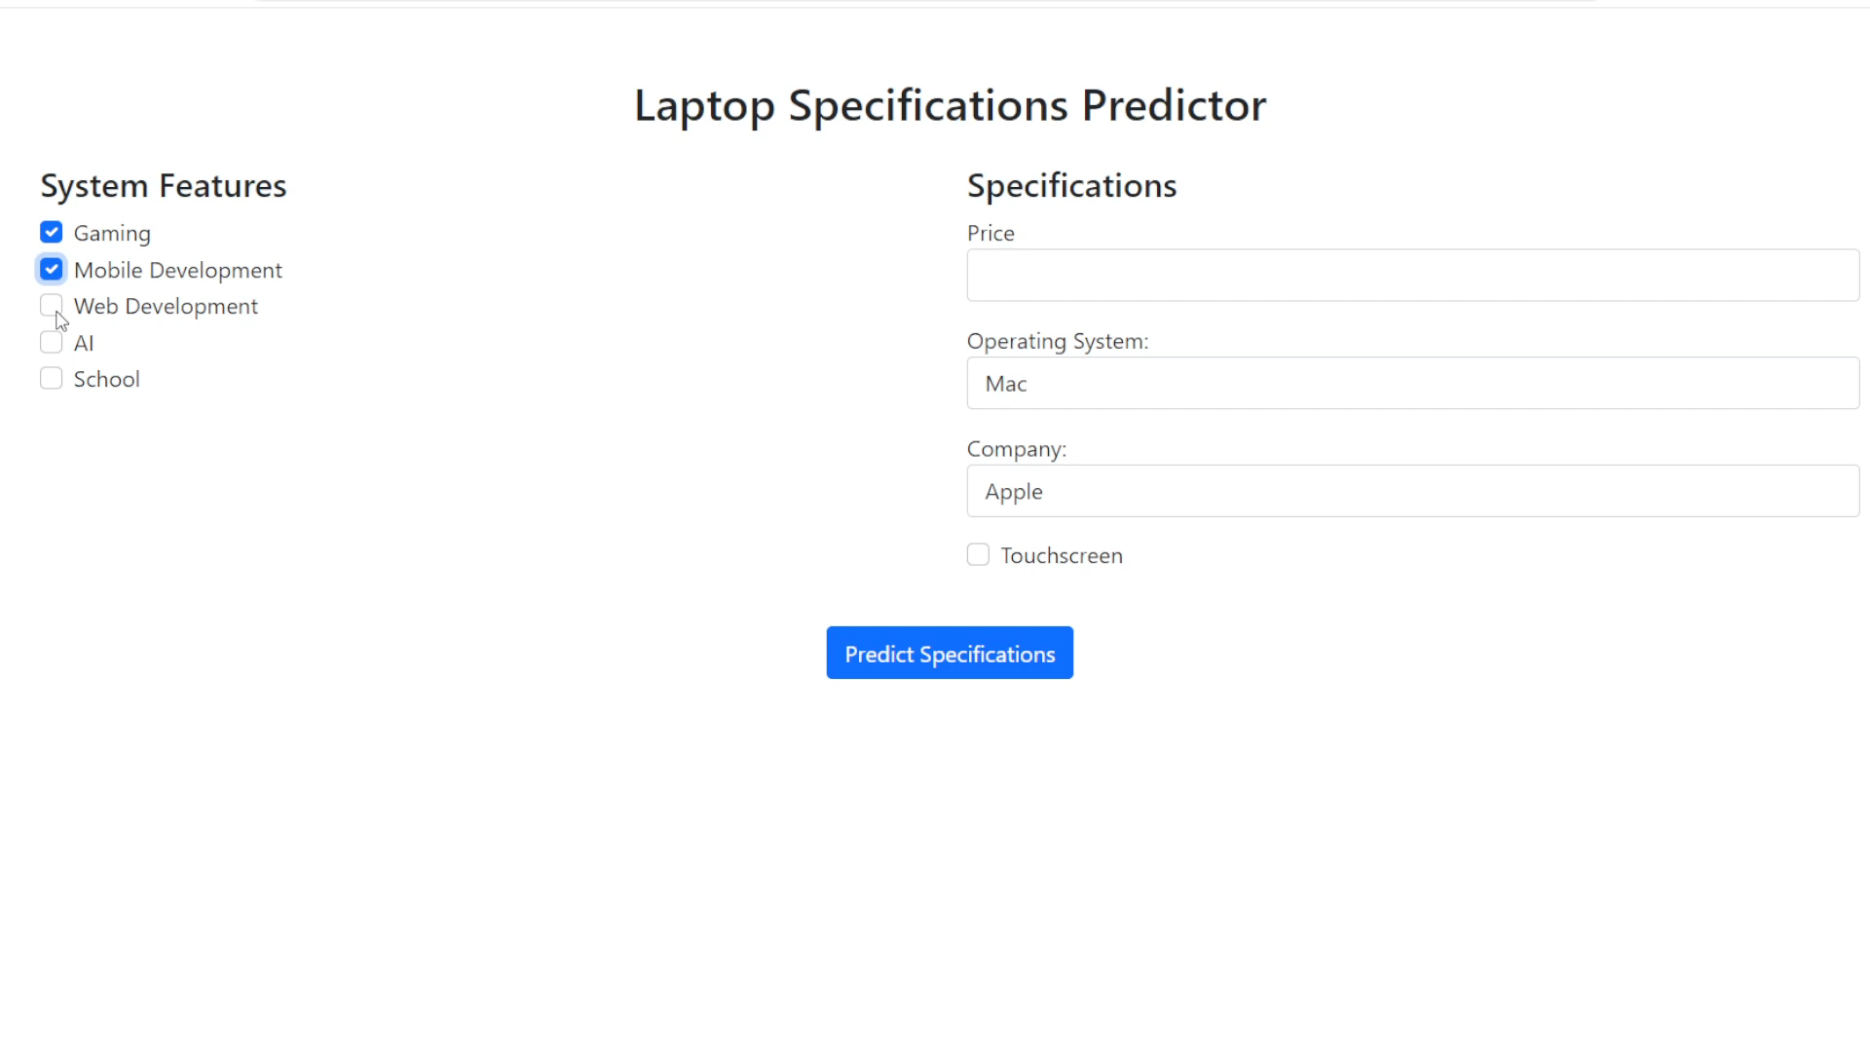
Introduction
State of art
Development Process
Project Review
What is Next ?
40

Slide 49
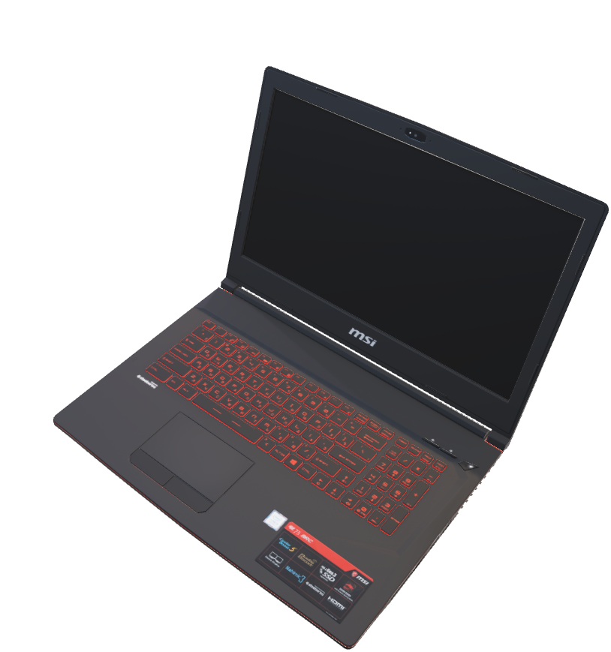
Introduction
State of art
Development Process
Project Review
What is Next ?
Next goals :
Expanding the dataset to enhance the efficiency
of our model.
Enabling the model to predict the required HDD
and SSD capacities, along with other specifications.
Enabling the model to recommend device models instead of requiring them as input.
41
Notes:
These are our next goals, which we aim to achieve as the upcoming challenges of the project.
As you can see, our project is highly scalable and will experience significant updates over time.

Slide 50





Our Contact
Thank you for your attention
Mohamed Moussa
moussamohamed@fss.u-usf.tn
+21653423830
Abdellatif Shili
shiliabdellatif@fss.u-usf.tn
+21650714059
42
Notes:
We have reached the end of our presentation! Here are our contact details. Thank you for your attention!

Slide 51
Our Contact
Thank You for your attention
Mohamed Moussa
moussamohamed@fss.u-usf.tn
+21653423830
Abdellatif Shili
shiliabdellatif@fss.u-usf.tn
+21650714059
43

